Slide 1
Project Two
DriversPass System Design Documents

Slide 2
Table of Contents
Slide 3: System Requirements
Slide 4 Use Case Diagram
Slide 5: Activity Diagram 1
Slide 6: Activity Diagram 2
Slide 7: Sequence Diagram
Slide 8: Class Diagram
Slide 9: Non-Functional Requirements
Slide 10: Functional Requirements
Slide 11: Technical Requirements
Slide 12: Security Requirements
Slide 13: System Limitations

Slide 3
System Requirements
Different levels of access. All access for Ian, Secretary, and Liam
Ability for users and employees (with access) to make, cancel, or modify appointments
Ability to print an activity report
Send feedback when any modifications are made in the system for example a reservation being made or cancelled.
2 hour lessons day and time of lesson
Return the user, the assigned driver and car, time of training
Set pickup location to drop location but also allow them to be modified
Users the ability to reset their password
Get notifications for updates from the DMV with new rules, policies, or sample questions
Interface contains test progress, user’s information, drivers’ notes for the user, special needs, drivers’ photo, and users' photo.
The drivers notes need to include lesson time, start hour, end hour, and driver’s comments
Cloud database and storage
3 base packages for users to choose from
Package One: Six hours in a car with a trainer
Package Two: Eight hours in a car with a trainer and an in-person lesson where we explain the DMV rules and policies
Package Three: Twelve hours in a car with a trainer, an in-person lesson where we explain the DMV rules and policies—plus access to our online class with all the content and material. The online class also includes practice tests.
Since lessons are only two hours. Package time slots would be divided by two to determine how many lessons are included in each package.
Information needed to be stored and collected [first name, last name, address, phone number, state, and their credit card number, expiration date, and security code].

Slide 4
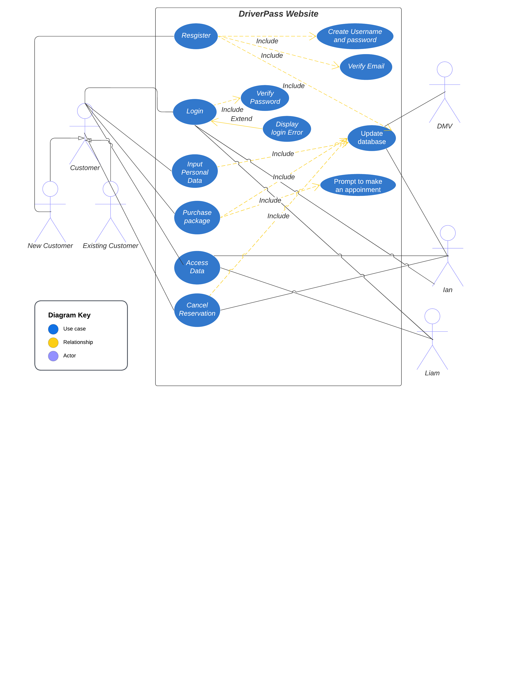
Use Case Diagram
Notes:
The use case diagram displayed shows the different object necessary to access and navigate the DriverPass website. Several objects have several objects attached to them. For example, the register object is related to the create username/password, verify email, and update database. They have an include relationship because once you perform the account registration the other 3 will process. The login object has another form of relationship where it is extended to a log in error message display. This message will not always be displayed because if a successful log in occurs the message is not necessary. The different actors in the scenario include the customer both new and existing as well as the DMV, Ian(IT specialist) and Ian the boss.

Slide 5
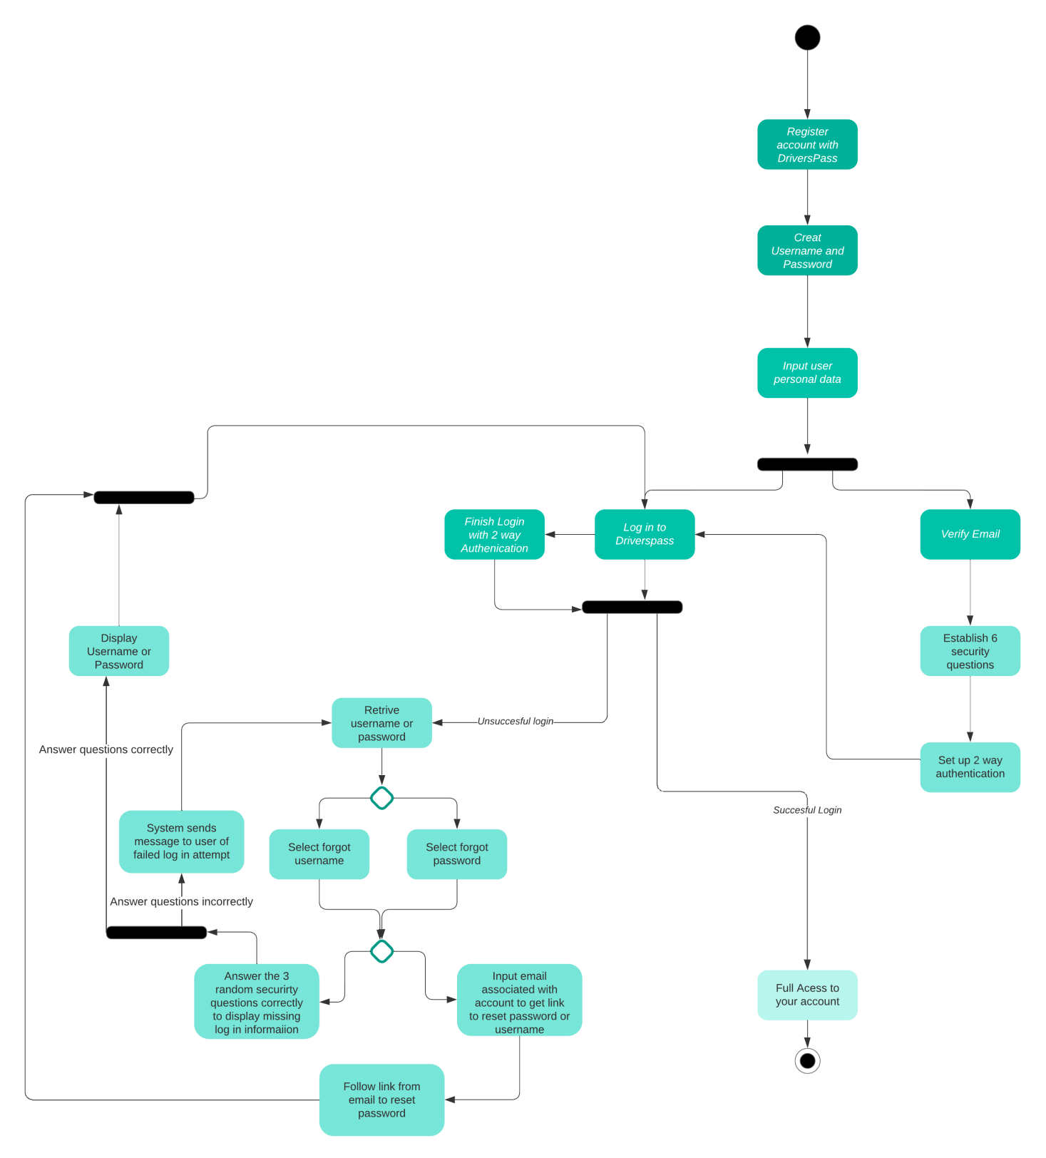
Activity Diagram #1
Notes:
The activity diagram above goes over the use case of registering and logging in to DriversPass. The register process begins with creating a username and password as well as inputting your personal data (such as email, address, driving history, and credit card information just to name a few examples). Next we reach our first fork in the diagram. You can go straight to log in process without a 2 way authentication or you can go to your registered email and verify it. While verifying your email you will select 6 questions/answers and 2 way authentication process which will lead to the log in process. The log in process leads to the 2 way authentication or to the next fork in the activity diagram. This fork involves whether the log in process is successful or not. If it is successful you will have access to your user account for DriverPass. If the log in process is unsuccessful the option to retrieve username and password appears. You have to make a decision here to either select the link to retrieve your username or password. Once you make that decision you reach another decision point. You can decide to either answer 3 of your 6 security questions at random or input the email associated with your account to get your username and a link to reset password sent to you. Once you click the link to reset your password you will go through the log in process again. If you instead choose to answer 3 random security questions your answers determine where the activity goes from there. If you answer the questions incorrectly the system will send an email to the associated email of the unsuccessful login attempt and you will be sent back to the username/password retrieval page. If you answer the questions correctly the username or password depending on what you chose earlier will be displayed on screen and then you will be sent to the log in page.

Slide 6
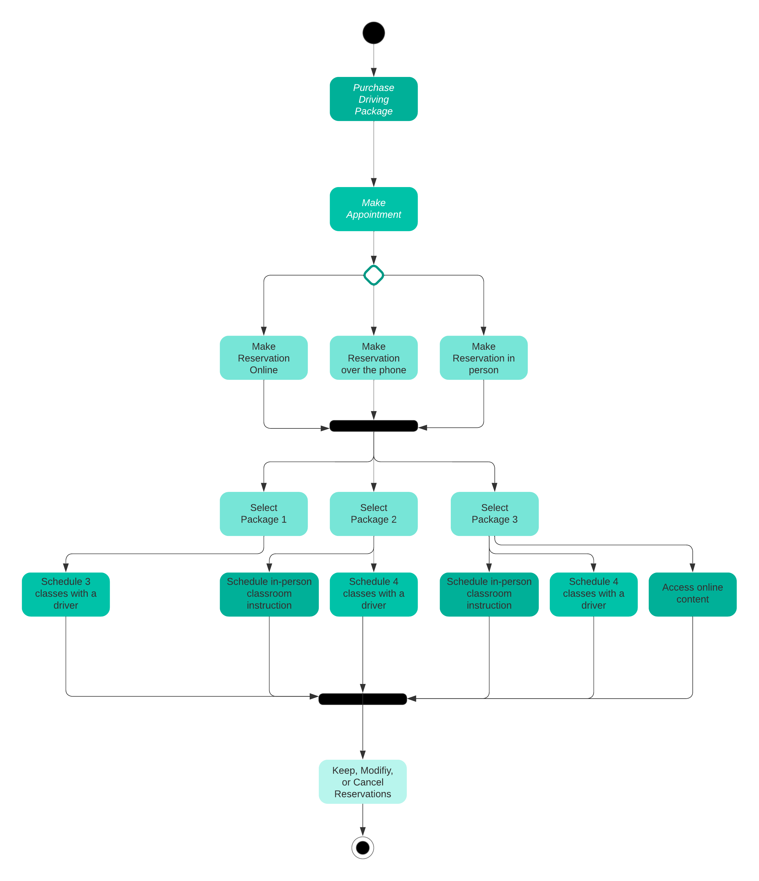
Activity Diagram #2
Notes:
The use case being described in the activity diagram displayed is purchasing a driving package. The process begins with making an appointment to make a reservation either online, on the phone, or in person. The reservation leads to the decision of package the user would like to purchase. The different functions with each package will then need to be scheduled. Lastly, you can either keep, modify, or cancel your reservation.

Slide 7
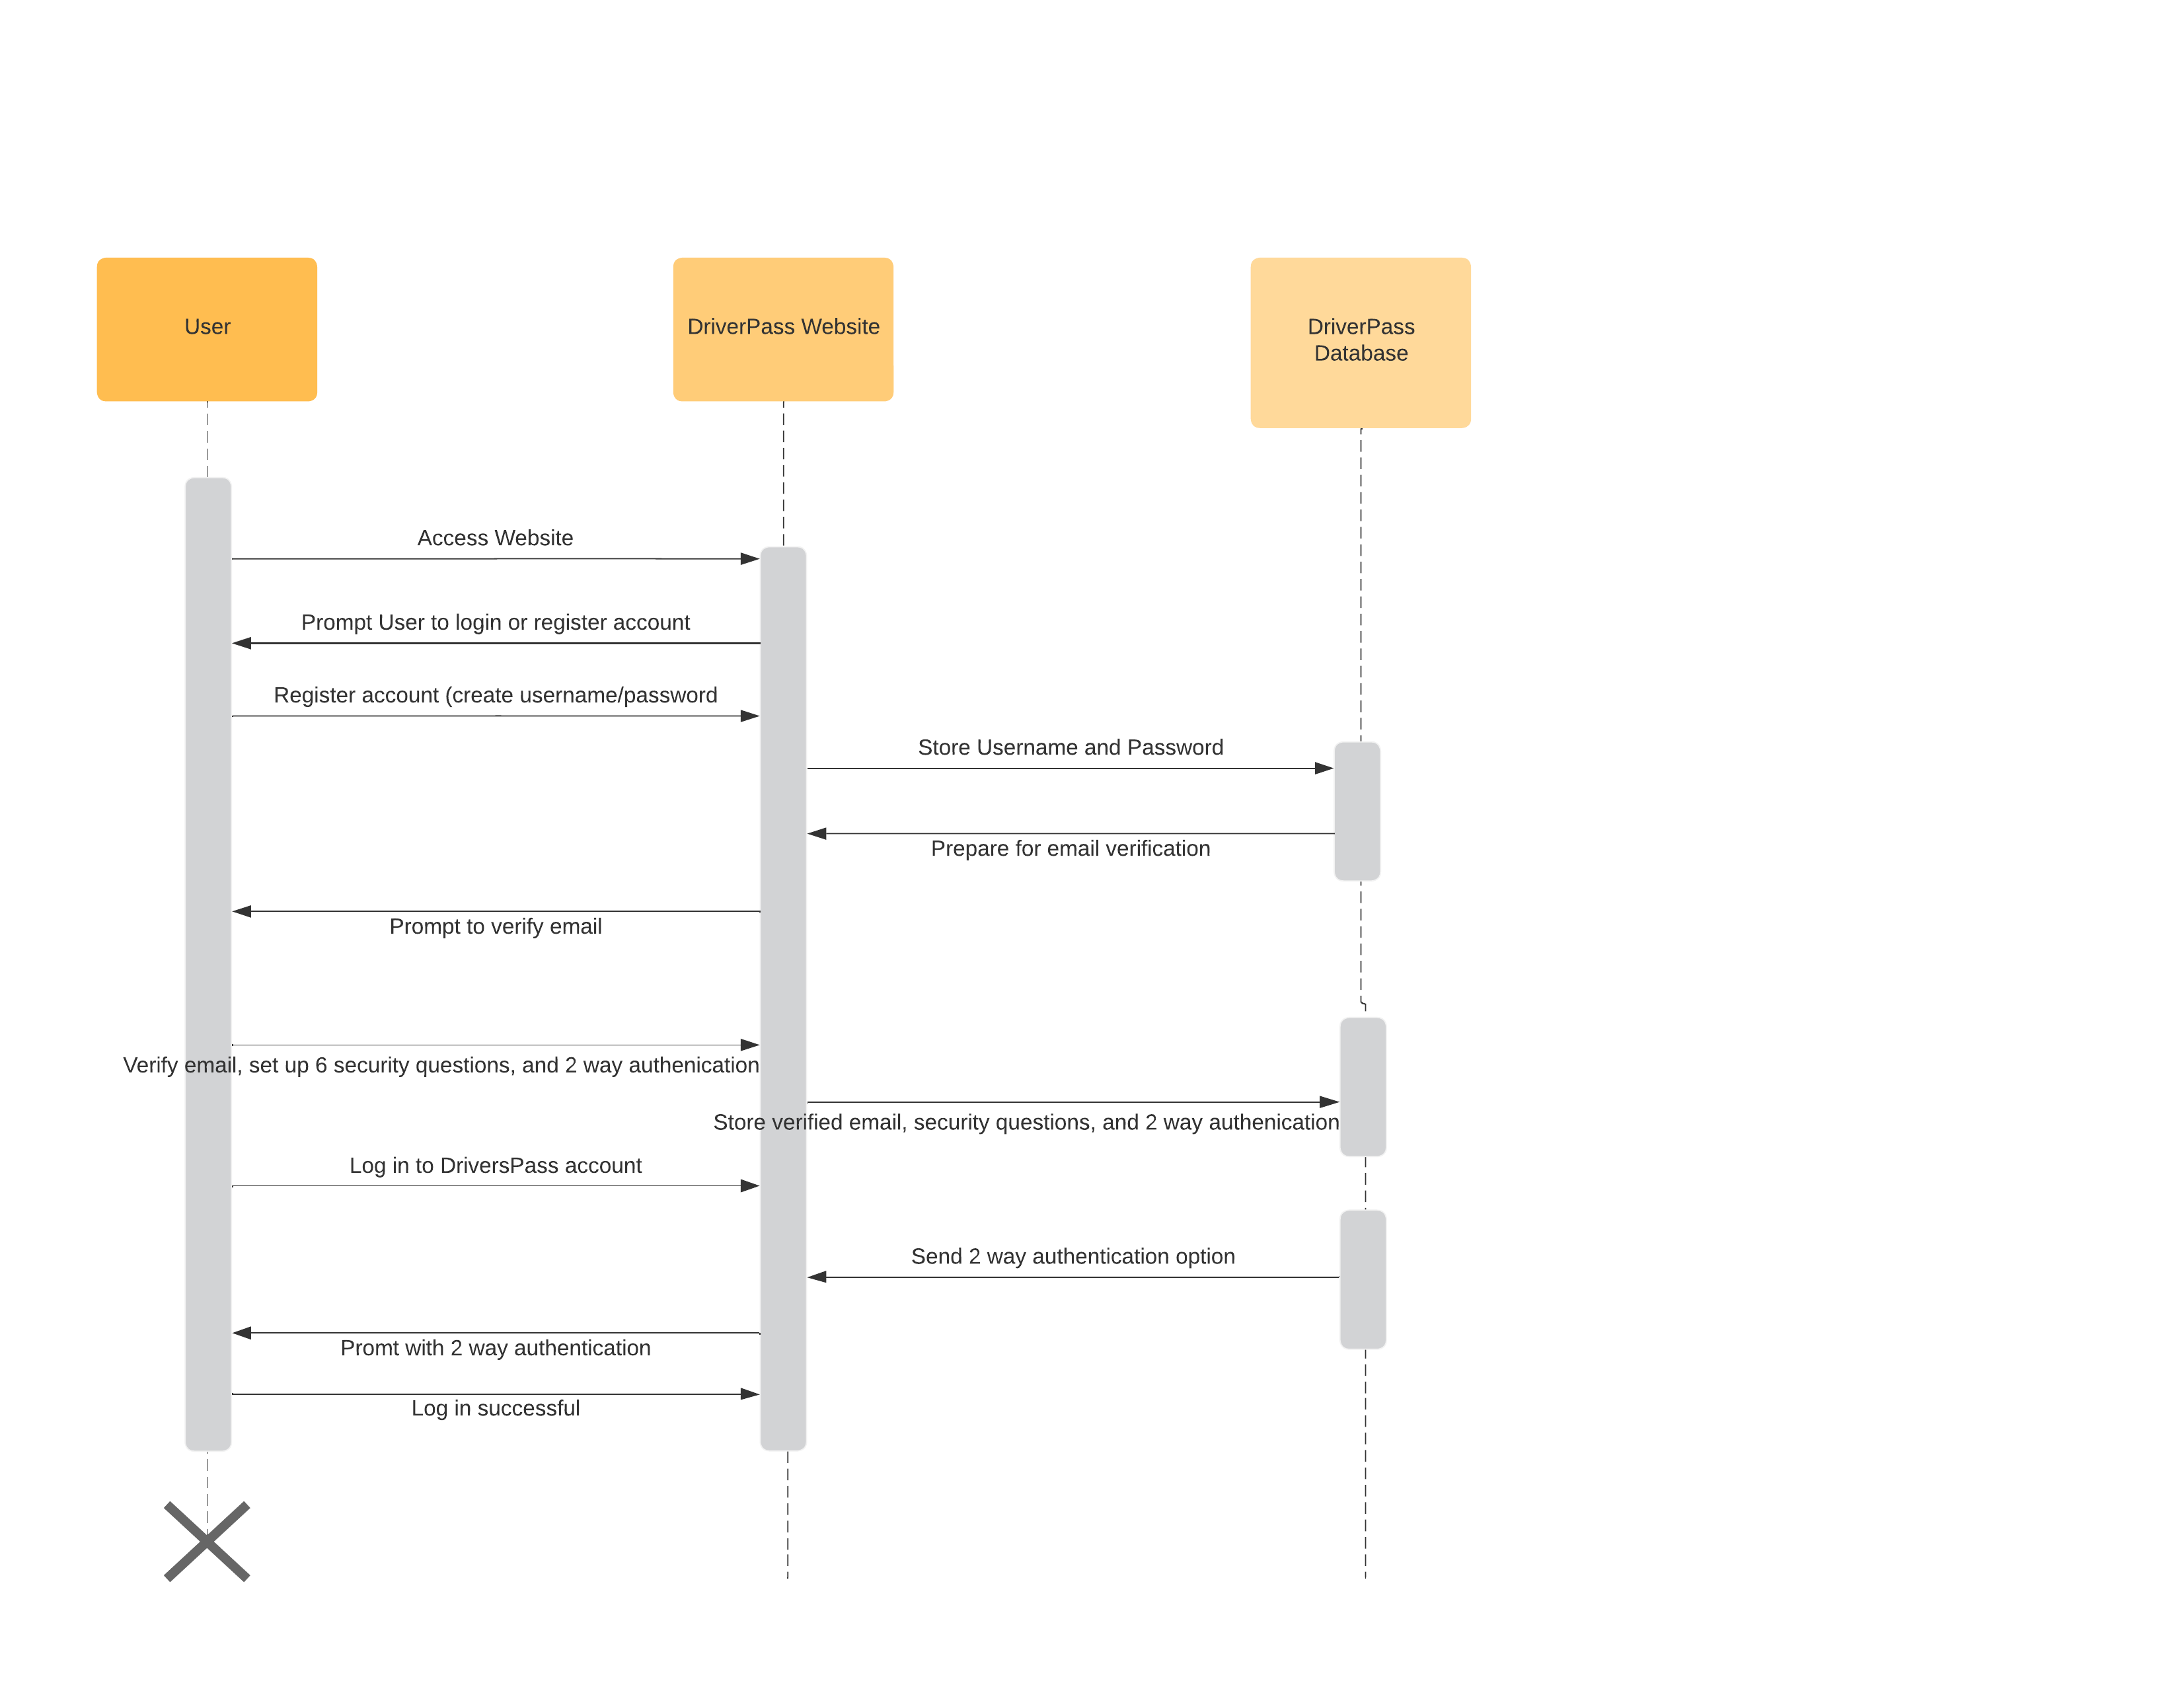
Sequence Diagram
Notes:
I chose to use the first activity diagram which described the use case of registering with the DriverPass website. The three characters in this diagram are the user, the website, and the database. The sequence begins with a user accessing the DriverPass website. The website will then prompt the user to login or register if they don’t have an account. The User will then register an account where the website will pass the admin data to the database. The database will use the stored email address to send the website the option to verify the email. The user will follow the link to verify, make security questions and set up 2 way authentication. These login methods will be passed to the website and then stored into the database. Once this registration process is complete the user can login and access the website.

Slide 8
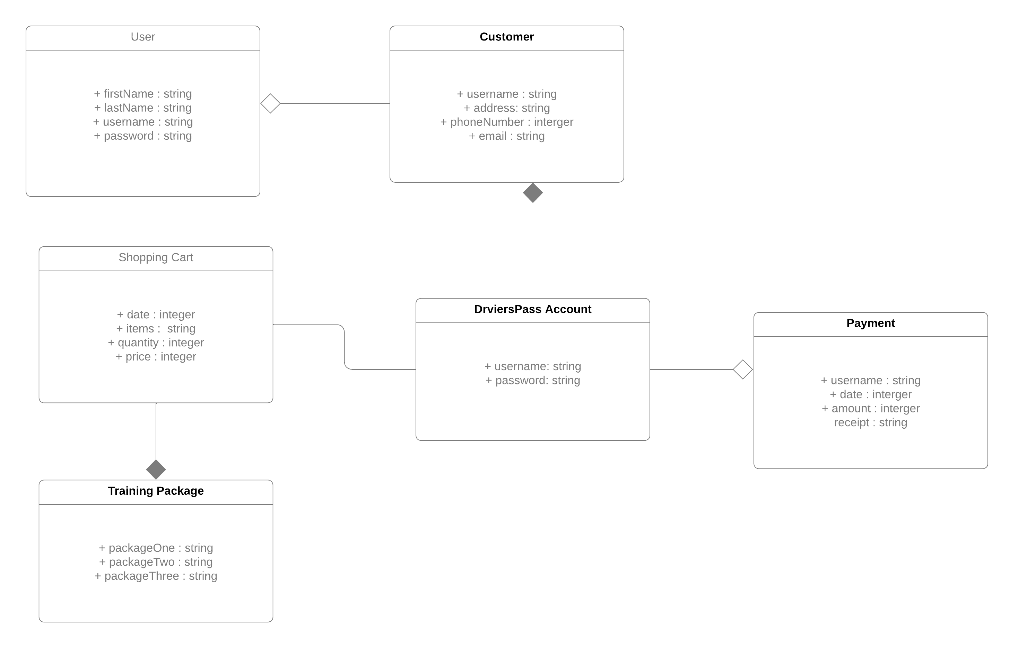
UML Class Diagram
Notes:
The above UML Class diagram provides the classes necessary to begin developing the code for DriverPass website. The class users is the start since everyone on the website will need to input admin data and create a username/password. The user class has an aggregation relationship with customer because a user is not always a customer. A user could also be the employees of DriverPass. The customer has a composite relationship with the DriverPass account because if the account goes away so does the customer. The DriverPass account is also linked to the payment and shopping cart class. The shopping cart class extends the training package.

Slide 9
Non-Functional Requirements for Diagrams
The environment that this system needs to run in is web-based (any software that can use cloud based storage) and mobile app (both apple and android)
The systems need to be fast enough for users to interact with the program without delays.
The system needs to be updated every time a user interacts with the system and makes a change in the schedule. The way the system can be completely accurate when showing appointment and trainer availabilities.
The different users will be distinguished based on their username.
The platforms for the design will include Windows, Mac OS, Android, iOS, and Linux.
The admins need to be alerted of any technical issues immediately.
The ability to modify code at anytime is imperative.

Slide 10
Functional Requirements
The system shall validate user credentials when logging in
The system shall update the user when any update is made to their account
The system shall provide the user times, prices, and options for online and driving training
The system shall provide the user a transcript of all completed training
The system shall allow admins to update it as necessary
The system shall provide updates when the DMV updates its bylaws
The system shall protect its users information and data
The interface needs to display the online test progress, user personal information, driver’s notes, special considerations, and driver/user photo.
The different user’s for this interface are the drivers, IT admins, and customers

Slide 11
Technical Requirements
A computer necessary for web design needs a large hard disk and Random Access Memory(RAM), high processing speed and large storage capacity to be able to process the large files
A server to work on and host the website
A network to build on
Strong antivirus or software that prevents the website from potential external threats
The ability to perform system back ups
Optimization of the website so that it can be accessed by mobile devices
A database to store user information
Some tools to build websites could include Sublime Text. Chrome Developer Tools, jQuery, GitHub, CodePen, Angular, Sass

Slide 12
Security
The requirements for the user to login would be a username/password and a two-way authentication built in with security questions. A challenge response through the use of a captcha will also be built in for security.
You can secure the connection or data exchange between client and server by using cybersecurity and cloud security together. One to protect the network and the other to protect the server.
If there is a brute force hacking attempt the account will be locked after 3 failed login attempts
If the user forgets their password there will be an option to send a reset password link to an alternate email that has been previously verified by the user. You can also select the option to input 3 of your security questions to reset your password on the website.

Slide 13
System Limitations
The limitations of this system are based on my lack of time and experience to develop
The limitations I see in my system design boil down to the lack of details surrounding how the different parts of the system will actually be made and how they will all perform together.
The limitations that I have naturally were that resources are limited to just the one interview, 5 months of time, a budget that hasn’t been discussed, and technology that must be able to work with the different platforms for testing and coding purposes.

